Slide 1
CITY GENERAL HOSPITAL OPERATIONAL PERFORMANCE ANALYSIS
PRESENTED BY: ADEMIJUBE VICTORIA

Slide 2
Problem Statement
City General Hospital is facing operational breakdown across various departments.
There is an overcrowded emergency department and patients and preparation.
Some staff are complaining of high workload.
Medication stock is mismanaged leading to shortages and waste of expired excesses.
High rate of inconclusive lab tests.
Insurance reimbursement is inconsistent.

Slide 3
Objectives
To understand patient demographics.
To examine admission types to detect patterns in emergency spikes.
To evaluate doctor workload distribution.
To assess medication utilization patterns.
To find the root causes of inconclusive laboratory results
To analyse billing and insurance data to uncover underpaying insurance providers

Slide 4
Dataset Overview
Data Source
City Hospital Dataset
Original dataset structure
55500 rows and 17 columns
Cleaned dataset structure
55500 rows and 19 columns
Data cleaning
No rows with errors
No duplicates rows
No missing values
No data inconsistencies

Slide 5
Methodology
Tools & Techniques
Microsoft Excel (Pivot Tables, Pivot Charts, Slicers).
Data cleaning and transformation in Excel.
Dashboard layout and visualization best practices.
Basic descriptive analytics and KPI design.
Added columns
Age group
Admissions duration

Slide 6
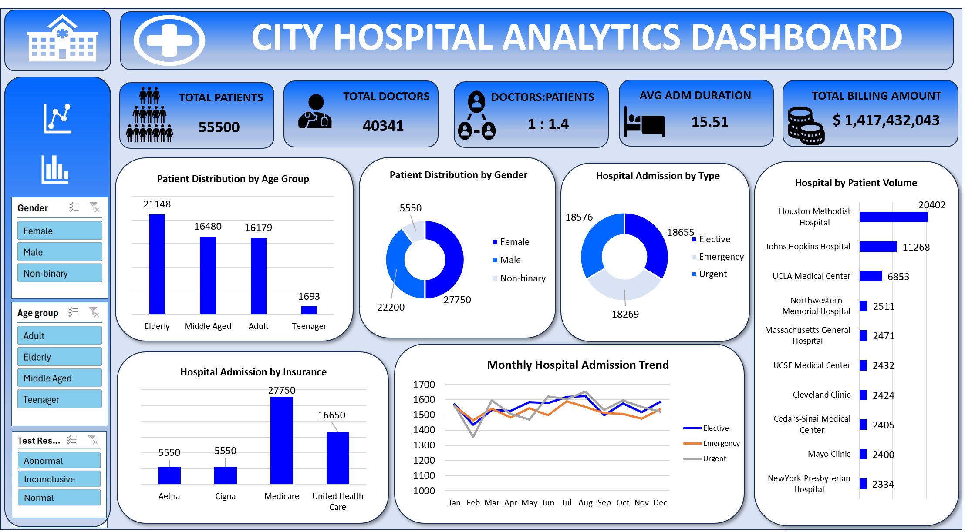

Slide 7
Data Insight
Total patients: 55500
Total Doctors: 40341
Teenagers represent the smallest group (1,693), 3% of the population
The population is more of elderly (21,148).
The admission types are almost evenly distributed.
Elective admissions being the highest (18,655).
Monthly admissions are consistent, showing no extreme spikes.
Medicare Insurance has the highest enrolment, with 50% of the patients (27,750).

Slide 8
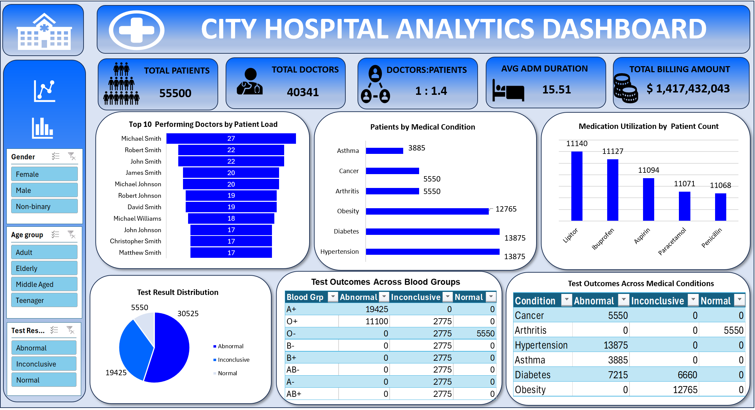

Slide 9
Data Insight
Houston Methodist Hospital is handling a disproportionately high patient volume.
This is more than one-third of the patients (20,402).
Some doctors are handling significantly more patients than others.
The top ten performing doctors had patient load varying between 17–27 patients.
Meanwhile, the doctor to patient ratio is 1 : 1.4.
Hypertension and Diabetes are the leading conditions (13,875 each).

Slide 10
Data Insight
Inconclusive test results were of most blood groups are the same count, 2775.
This suggests that there could lab operational error.
Only patients with obesity and diabetes had inconclusive test results.
This could be related to investigations for diabetes and obesity.
There is not much difference between the number of drugs used, however, Penicillin is the least prescribed medication.

Slide 11
Recommendation
Redistribute doctor and hospital workload.
Strengthen chronic disease management pathways such as hypertension and diabetes.
Adopt a hospital-wide digital health system.
More data should be collected on insurance and amount reimbursed.
Equipment used for diabetes and obesity investigations should be inspection.
Implement a rea-time stock monitoring system to track stock balance of drug, expiry dated and daily trend.

Slide 12
THANK YOU

